Slide 1
Day 5
Unsupervised Learning

Slide 2
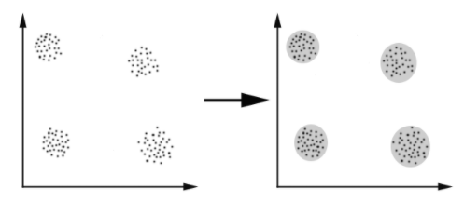
Clustering
Clustering can be considered the most important unsupervised learning problem; so, as every other problem of this kind, it deals with finding a structure in a collection of unlabeled data. A loose definition of clustering could be “the process of organizing objects into groups whose members are similar in some way”. A cluster is therefore a collection of objects which are “similar” between them and are “dissimilar” to the objects belonging to other clusters.

Slide 3
Types Of Clustering
Centroid-based
Density-based
Distribution-based
Hierarchial

Slide 4
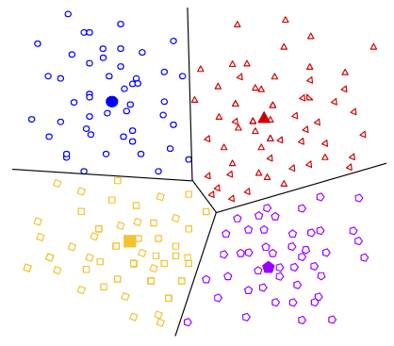
Centroid-based Clustering
It organizes the data into non-hierarchical clusters, in contrast to hierarchical clustering defined below. k-means is the most widely-used centroid-based clustering algorithm. Centroid-based algorithms are efficient but sensitive to initial conditions and outliers.

Slide 5
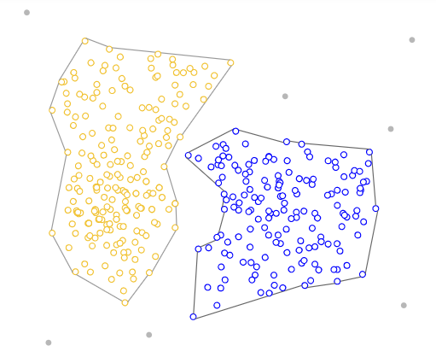
Density-based Clustering
It assumes data is composed of distributions, such as Gaussian distributions. In the picture, the distribution-based algorithm clusters data into three Gaussian distributions. As distance from the distribution's center increases, the probability that a point belongs to the distribution decreases. The bands show that decrease in probability. When you do not know the type of distribution in your data, you should use a different algorithm.

Slide 6
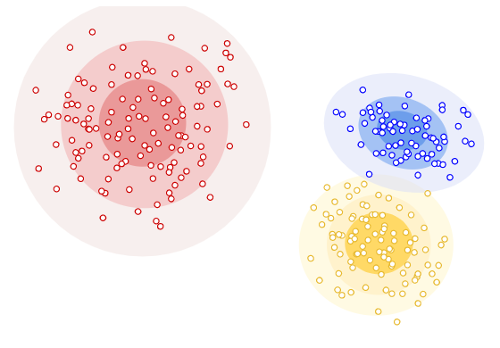
Distribution-based Clustering
It assumes data is composed of distributions, such as Gaussian distributions. In the picture, the distribution-based algorithm clusters data into three Gaussian distributions. As distance from the distribution's center increases, the probability that a point belongs to the distribution decreases. The bands show that decrease in probability. When you do not know the type of distribution in your data, you should use a different algorithm.

Slide 7
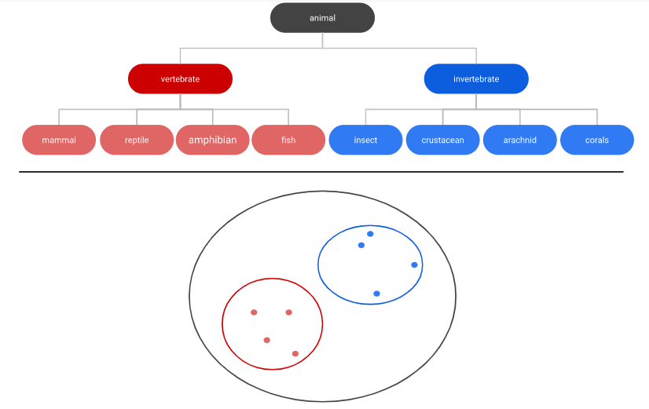
Hierarchial Clustering
"Hierarchical clustering" creates a tree of clusters. Hierarchical clustering, not surprisingly, is well suited to hierarchical data, such as taxonomies.

Slide 8
K-Means Clustering

Slide 9

K-Means Clustering
The K-Means algorithm clusters data by trying to separate samples in n groups of equal variance, minimizing a criterion known as the inertia or within-cluster sum-of-squares. This algorithm requires the number of clusters to be specified. It scales well to large number of samples and has been used across a large range of application areas in many different fields.
The K-means algorithm aims to choose centroids that minimise the inertia, or within-cluster sum-of-squares criterion:

Slide 10
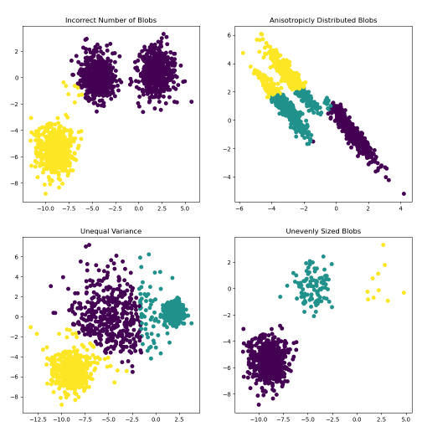
K-Means Clustering

Slide 11
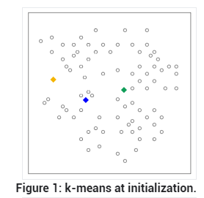
Step 1
The algorithm randomly chooses a centroid for each cluster. In our example, we choose a k of 3, and therefore the algorithm randomly picks 3 centroids.

Slide 12
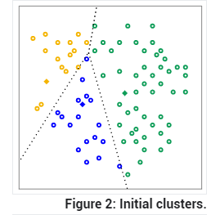
Step 2
The algorithm assigns each point to the closest centroid to get k initial clusters.

Slide 13
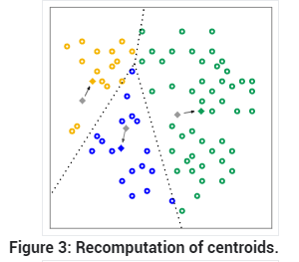
Step 3
For every cluster, the algorithm recomputes the centroid by taking the average of all points in the cluster. The changes in centroids are shown in Figure 3 by arrows. Since the centroids change, the algorithm then re-assigns the points to the closest centroid. Figure 4 shows the new clusters after re-assignment.

Slide 14
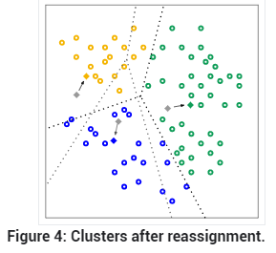
Step 4
The algorithm repeats the calculation of centroids and assignment of points until points stop changing clusters. When clustering large datasets, you stop the algorithm before reaching convergence, using other criteria instead.

Slide 15
Mini Batch K-Means

Slide 16
K-Means Clustering
The MiniBatchKMeans is a variant of the KMeans algorithm which uses mini-batches to reduce the computation time, while still attempting to optimise the same objective function. Mini-batches are subsets of the input data, randomly sampled in each training iteration. These mini-batches drastically reduce the amount of computation required to converge to a local solution. In contrast to other algorithms that reduce the convergence time of k-means, mini-batch k-means produces results that are generally only slightly worse than the standard algorithm.

Slide 17
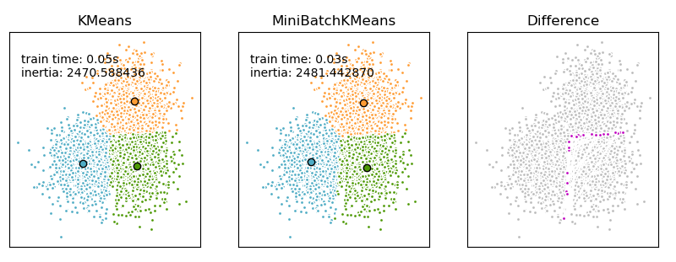
K-Means Clustering

Slide 18
Colab Zamanı!

